Slide 1
Designing Testable Applications
Part II: DB Integration & Legacy Code

Slide 2
Agenda
Objectives
Database Integration: Tips & Samples
Legacy Code Refactoring: Tips & Samples
Coding time!
Feedback
Summary

Slide 3

Objectives
Divulge the use of best practices such as unit & integration testing and continuous integration
Provide developers with the necessary tools to design and develop applications using these practices (How?)
Advantages of using these practices (Why?)
I have inherited non-testable legacy code. Where do I start?

Slide 4
Database Integration: Tips & Samples

Slide 5
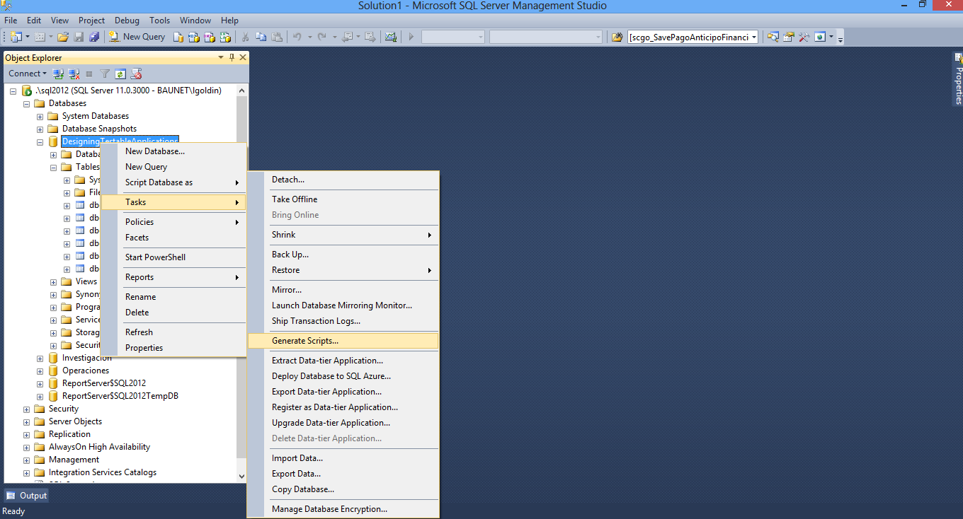
Tip 1: Generate creation scripts for DB, Tables, Views, SPs, Functions

Slide 6
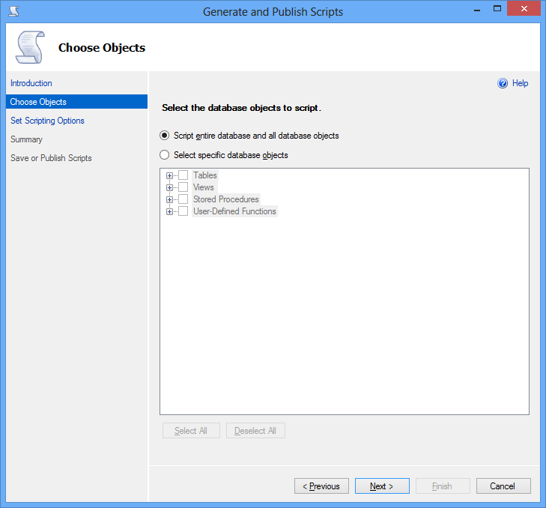
Tip 1: Generate creation scripts for DB, Tables, Views, SPs, Functions

Slide 7
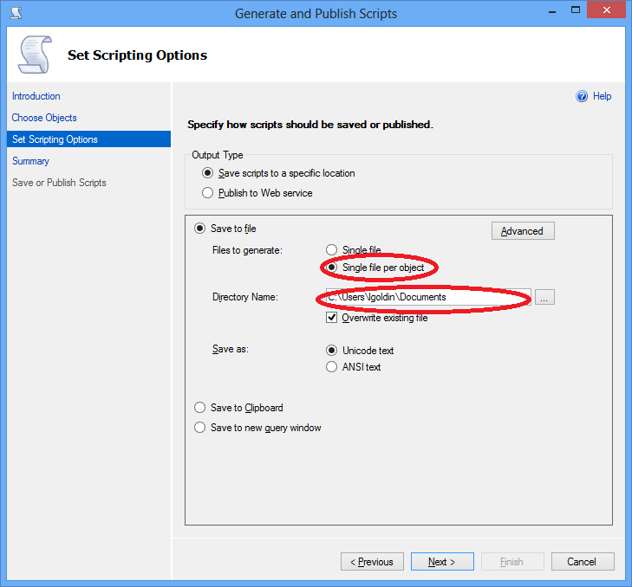
Tip 1: Generate creation scripts for DB, Tables, Views, SPs, Functions

Slide 8
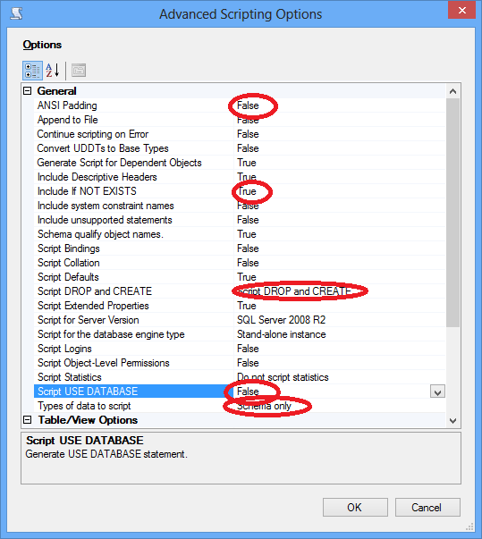
Tip 1: Generate creation scripts for DB, Tables, Views, SPs, Functions

Slide 9
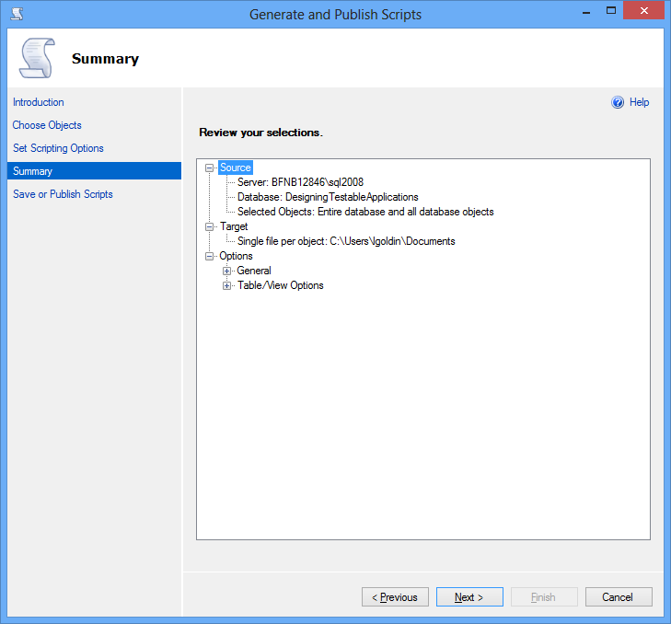
Tip 1: Generate creation scripts for DB, Tables, Views, SPs, Functions

Slide 10
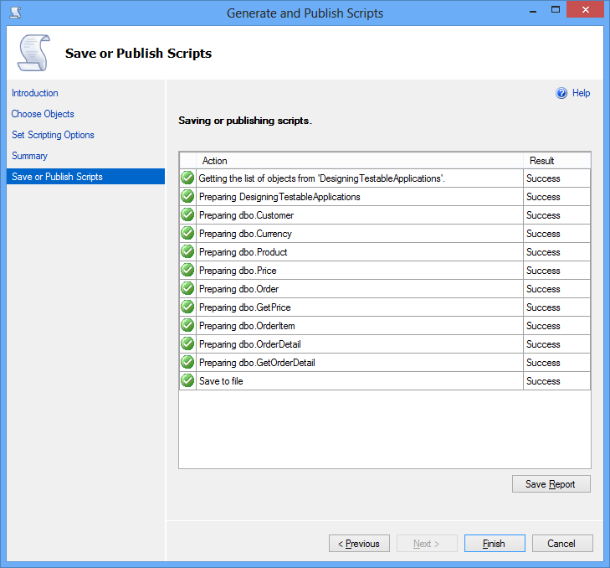
Tip 1: Generate creation scripts for DB, Tables, Views, SPs, Functions

Slide 11
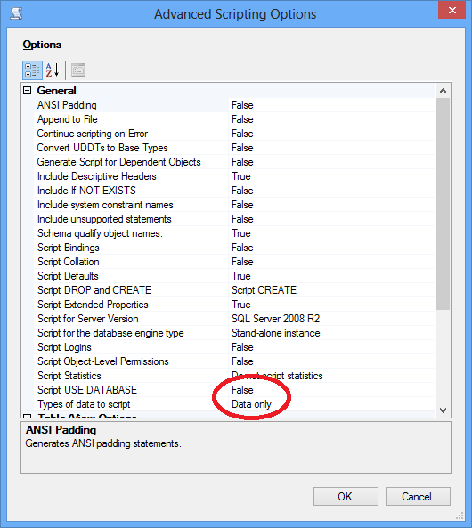
Tip 2: Generate “master” data insertion scripts

Slide 12
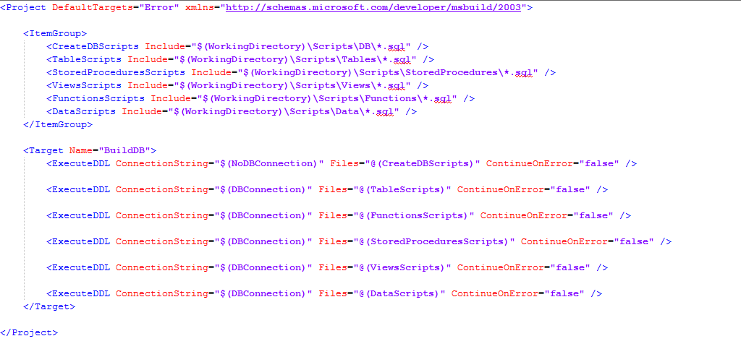
Tip 3: Execute scripts automatically

Slide 13
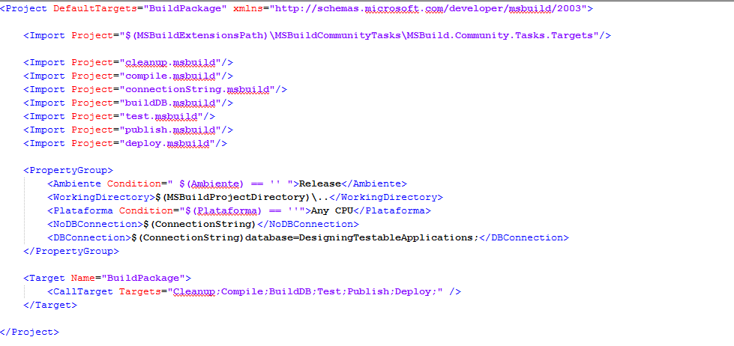
Tip 3: Execute scripts automatically

Slide 14
Tip 4: Setup test data (initialization & cleanup)
Test Initialization
Initialize the database context and/or transactions
Add test data that you may need in tests
Test Cleanup
Return the database to its original state to allow tests to be run multiple times with the expected result
Delete test data and/or rollback transactions
Make sure database connections are disposed

Slide 15
Tip 5: Generate Integration tests
How to write integration tests:
Setup preconditions
Execute the code to be tested
Assert on the expected results
A good integration test:
Documents your design
Can be run in any order if part of many other tests
Consistently returns the same result
Tests a single logical concept in the system
Is named clearly and consistently
Is readable
Is maintainable

Slide 16
Tip 6: Add Integration Tests to MSBuild
Abcdefghi

Slide 17
Legacy Code Refactoring: Tips & Samples

Slide 18
Working with Legacy Code
Abcdefghi

Slide 19
Tip 1: Decouple method code
Abcdefghi

Slide 20
Tip 2: Test method
Abcdefghi

Slide 21
Tip 3: Refactoring
Abcdefghi

Slide 22
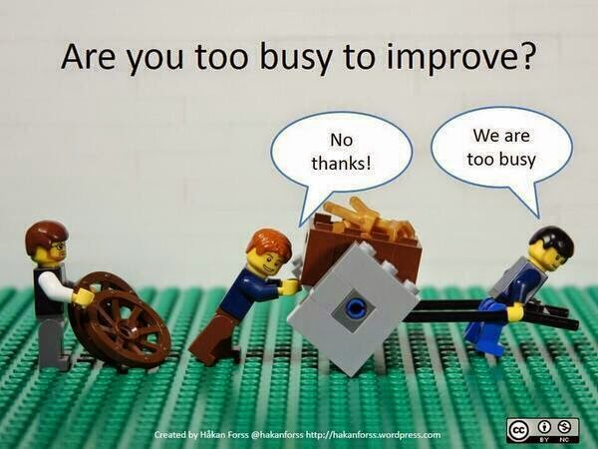
Tip 3: Refactoring

Slide 23
Coding time!

Slide 24

Questions

Slide 25
Feedback

Slide 26
Feedback
What do you think about using these practices in your projects?
What advantages would you have by incorporating these practices in your current project?
What’s your take on the concepts of today’s talk?

Slide 27
Summary

Slide 28
Summary
These practices:
Make your code more maintainable
Minimize the number of errors in the final product
Allow early detection of errors in the development environment
Reduce development and maintenance time over the project’s lifecycle
Improve the quality of the final product

Slide 29
Summary
These practices will also:
Improve the development team’s internal organization
Maintain a current build always available for testing, demos or deployment
Allow you to generate metrics of code quality, test coverage, etc.

Slide 30
Part III: Scenes of the next episode…
No, it’s over, just kidding…

Slide 31
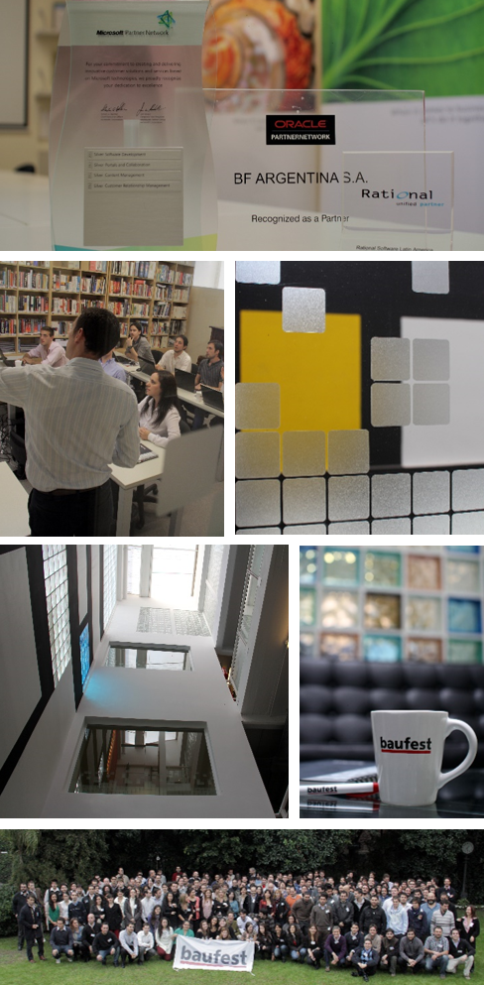





Thanks! Leandro Goldin lgoldin@baufest.com Christian Smirnoff csmirnoff@baufest.com
USA
Tel +1 (617) 275-2420 1 Broadway 14th floor Cambridge, MA 02142
USA
Mexico
Tel.: +52 (55) 5531-8878 Fax: +52 (55) 5531-8878 Avda. Ejército Nacional 678, Col. Polanco Reforma,
Distrito Federal C.P. 11550
México D.F.
Argentina
Buenos Aires
Tel.: +54 (11) 4118-8080
Fax: +54 (11) 4118-8080
Roosevelt 1655
C1428BNC, Buenos Aires
Argentina
Santa Fe
Tel.: +54 (342) 412-0368
San Jerónimo 1838
S3000FPP, Santa Fe
Argentina
Spain
Tel.: +34 91 745-2763
Fax: +34 91 561-5626
c/ Francisco Giralte, 2
28002, Madrid
Spain

